Slide 1
Customer Data Analysis
PRDA – 05
TEAM ID: PTID – CDA – NOV – 25 – 825
BY:
Akshath Shetty
Navya Varanasi
Kamepalli Siddardha
Kanal Ram Kumar Reddy

Slide 2
Project Overview / Introduction
The project aimed to analyze customer purchasing behavior and uncover insights related to gender, age, and payment preferences to help improve sales strategies and customer segmentation."
This dataset contains shopping information from 10 different shopping malls between 2021 and 2023.We have gathered data from various age groups and genders to provide a comprehensive view of shopping habits in Istanbul.
The dataset includes essential information such as:
invoice numbers,
customer IDs,
age,
gender,
payment methods,
product categories,
quantity, price,
order dates &
shopping mall locations.

Slide 3
Problem Statements
How is the shopping distribution according to gender?
Which gender did we sell more products to?
Which gender generated more revenue?
How is the shopping distribution according to age?
Which age category did we sell more products to?
Which age category generated more revenue?
Distribution of purchase categories relative to other columns?
Does the payment method have a relation with other columns?
How is the distribution of the payment method?
Visualize the data using Tableau /PowerBI and derive insights and give your inputs/suggestions to the company.

Slide 4
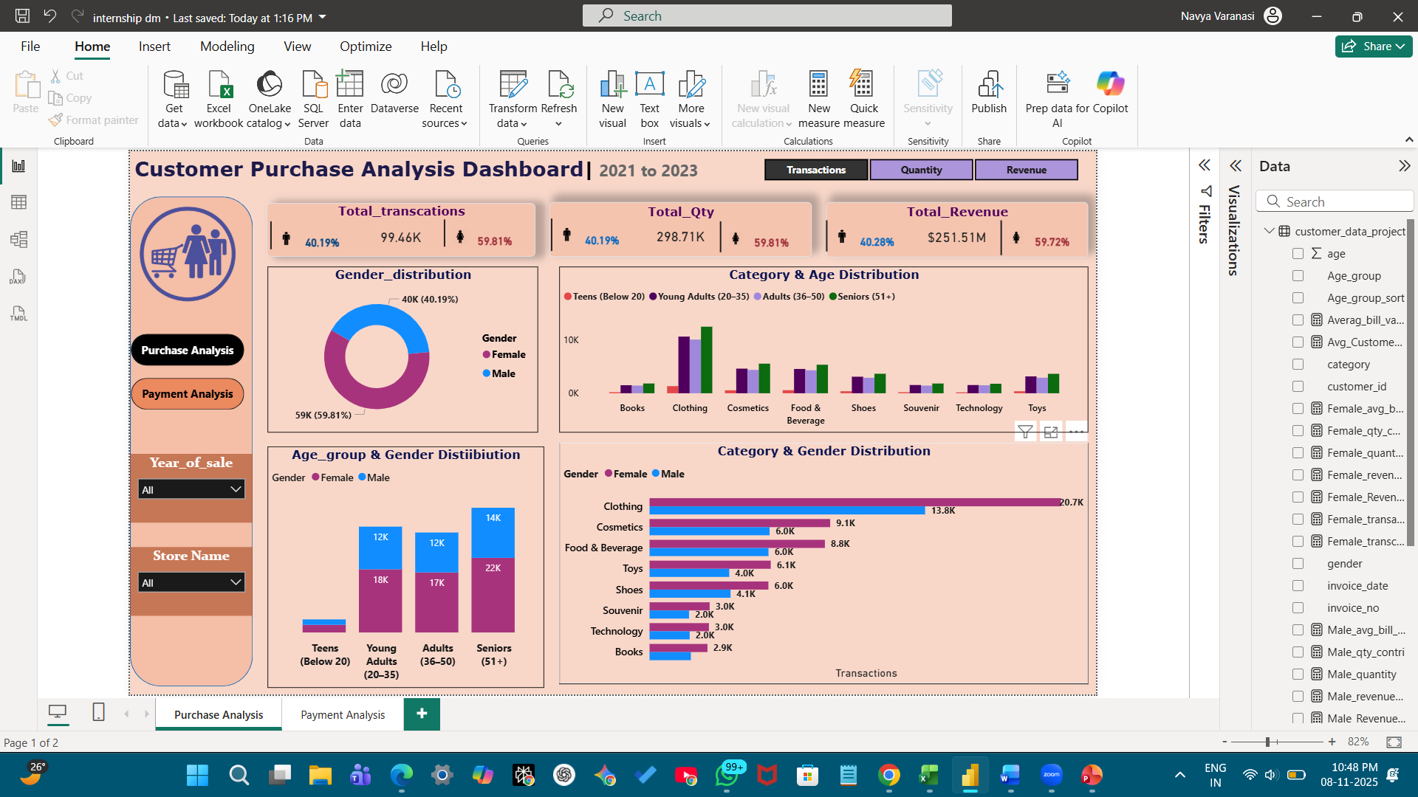

Visualizations & Insights - 1
How is the shopping distribution according to gender?
2. Which gender did we sell more products to?
Shopping Distribution by Gender
Females contributed 59.8% of total transactions vs 40.2% from males.
Insight: Female shoppers form the core customer base, showing higher store engagement and visit frequency.
Recommendation: Allocate more marketing budget to female-focused campaigns and loyalty programs.
Gender-wise Product Quantity Sold
Females purchased 178,659 items (59.8%), while males purchased 120,053 (40.2%).
Insight: Not only do women shop more often, they also buy larger volumes per visit, indicating stronger conversion rates and product interest.
Recommendation: Consider bundle or combo offers targeted at female customers.

Slide 5
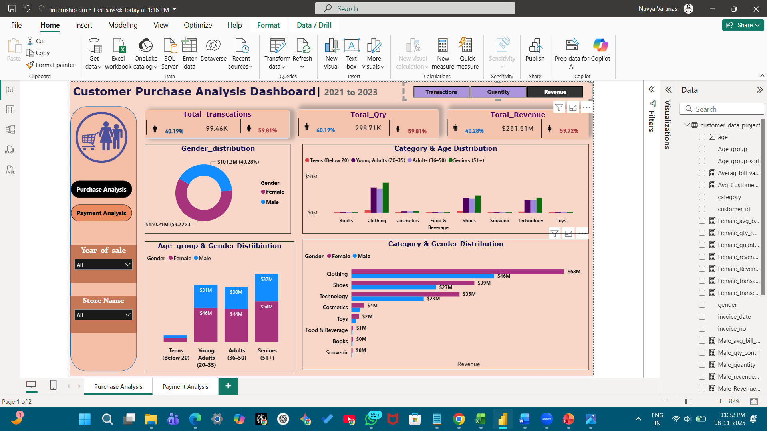
Visualizations & Insights - 2
3. Which gender generated more revenue?
4. How is the shopping distribution according to age?
Shopping Distribution by Age Group
Seniors (51+) - 36.3%
Young Adults (20–35) - 30.8%
Adults (36–50) - 29.1%
Teens (<20) - 3.8%
Insight: Seniors (51+) are surprisingly the most frequent shoppers, indicating loyalty and stable income effect.
Recommendation: Maintain personalized engagement for senior customers; introduce comfort-oriented product lines.
Gender-wise Revenue Contribution
Females generated ₹150.2M (59.7%), while males generated ₹101.3M (40.3%).
Insight: Revenue aligns with quantity trends — females are the primary revenue drivers across categories.
Recommendation: Maintain female-centric assortment in fashion and lifestyle segments.

Slide 6
Visualizations & Insights - 3
5. Which age category did we sell more products to?
6. Which age category generated more revenue?
Quantity Sold by Age Group
Seniors: 108,534 units (36.3%)
Young Adults: 91,997 units (30.8%)
Adults: 86,885 units (29.1%)
Insight: Older age segments (36+) account for nearly 65% of items sold, showing mature customers drive volume.
Recommendation: Offer discounts or memberships targeted at 35+ demographic groups.
Revenue by Age Group
Seniors (51+) - ₹91.3M 36.3%
Young Adults (20–35) - ₹76.9M 30.6%
Adults (36–50) - ₹74.2M 29.5%
Teens (<20) - ₹9.05M 3.6%
Insight: Seniors generate the highest revenue, followed closely by younger working professionals highlighting both loyalty and spending power.
RecommendationFocus marketing on Seniors (retention) and Young Adults (acquisition).

Slide 7
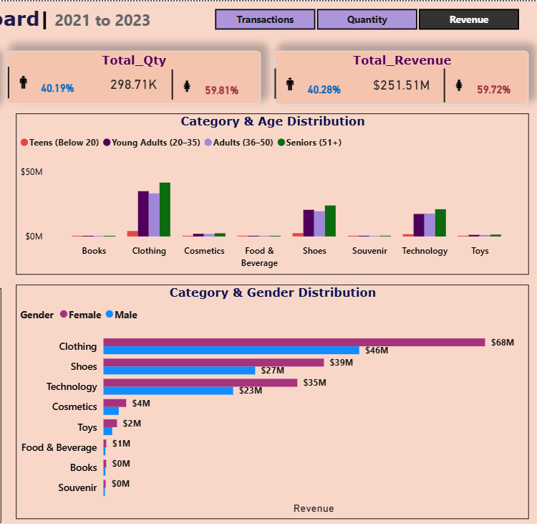
Visualizations & Insights - 4
7 . Distribution of purchase categories relative to other columns?
Clothing, Shoes, and Technology together account for nearly 90% of total revenue, making them the top-performing categories.
Across all categories, female customers lead sales (~60%), especially in Clothing, Shoes, and Cosmetics, indicating stronger interest in lifestyle and fashion
products.Seniors (51+) and Young Adults (20–35) are the two most active age segments, jointly contributing over two-thirds of total category sales.
Teens (<20) show the lowest participation (~4%), revealing potential for youth-oriented product promotions.
The sales pattern remains consistent across gender and age, showing a balanced but predictable consumer behavior across core product lines.

Slide 8
Visualizations & Insights - 5
8. Does the payment method have a relation with other columns?
9. How is the distribution of the payment method?
Cash dominates across all gender and age groups, especially among Seniors and Adults.
Credit Card usage is higher among Young Adults, indicating financial independence and digital preference.
Debit Card use is moderate and balanced across demographics.
Insight: Payment preference varies by age — cash for older shoppers, cards for younger ones.
Recommendation: Promote digital payment rewards and card offers for younger buyers, but retain cash facilities for older demographics.
Payment Method & Share of Transactions
Cash - 44.7%
Credit Card - 35.1%
Debit Card - 20.2%
Insight: Cash remains the most used mode (45%), though digital payments (55%) are collectively higher — showing a shift toward cashless behavior.
Recommendation: Strengthen digital infrastructure and run card-based loyalty schemes.

Slide 9
Overview of complete dashboard

Slide 10
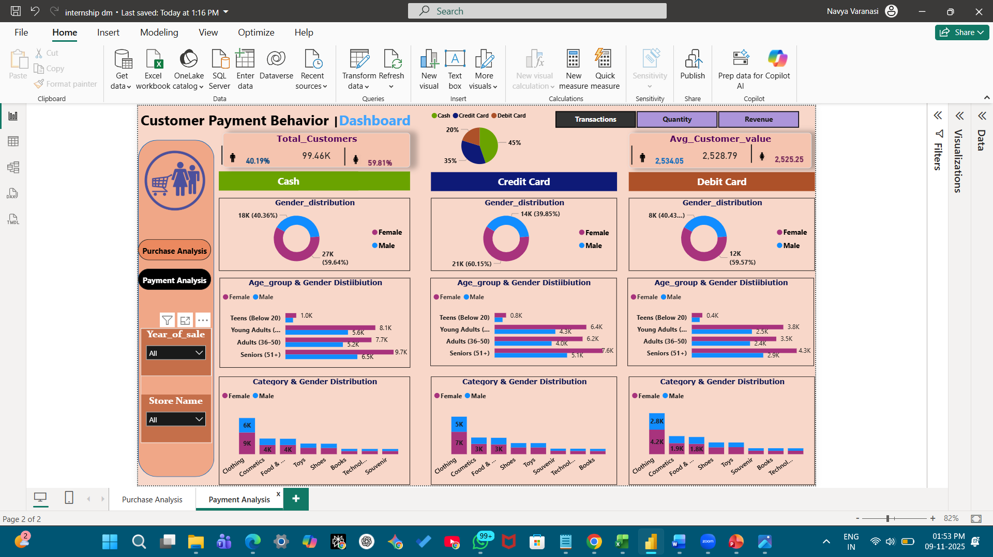
Overview of complete dashboard

Slide 11
Overall Business Insights & Strategic Recommendations
Overall Business Insights
Female & Senior customers drive the highest revenue and transaction volume.
Clothing, Shoes, and Technology are the top-earning categories.
Cash still leads, but digital adoption is accelerating.
Seniors (51+) show both high loyalty and purchasing power — a critical customer base.
Young Adults (20–35) are emerging digital buyers ideal for long-term customer retention programs.
Strategic Recommendations
Introduce personalized marketing for female and senior customers.
Launch digital payment cashback and card-based incentives.
Promote category-wise offers (Fashion Fridays, Tech Tuesdays).
Build loyalty program tiers by age and spend level.
Expand data tracking to understand seasonal and mall-level patterns.

Slide 12
THANK YOU

